Slide 1
A Multimodal Machine Learning Approach for Scrub Typhus Classification Using Clinical and Skin Image Data
Under the Guidance of
Dr. B.Prameela Rani
Assistant Professor
Department of Computer Applications
Presented By
P. Renuka Chowdary
24M11MC134
ADITYA UNIVERSITY, Surampalem, Kakinada
2025-2026

Slide 2
OUTLINE
Introduction
Problem Statement
Objectives
Literature Survey
Proposed System
System Architecture
Methodology / Algorithm
Results & Analysis
Technologies Used
Dataset / Input Details
Advantages
Limitations
Future Scope
Conclusion
References

Slide 3
INTRODUCTION
Scrub typhus is an infectious disease caused by the bacterium Orientia tsutsugamushi and spread through the bite of infected chigger mites. It is commonly found in tropical and subtropical regions, especially in Asia. People affected by this disease usually experience symptoms such as fever, headache, body pain, chills, sweating, vomiting, and a skin lesion called eschar. Early diagnosis of scrub typhus is difficult because these symptoms are similar to other diseases like dengue, malaria, and typhoid. Traditional diagnosis mainly depends on clinical observation and laboratory tests, which can sometimes take time and may lead to misdiagnosis. To overcome this problem, this project proposes a multimodal machine learning approach that uses both clinical symptom data and skin lesion images to detect scrub typhus. Machine learning algorithms such as Random Forest and Support Vector Classifier are used to analyze the clinical data, while deep learning models analyze skin images to identify patterns related to the disease. Explainable AI techniques like SHAP and Grad-CAM++ are also used to understand how the model makes predictions. By combining both clinical and image data, the system aims to improve the accuracy of scrub typhus detection and support doctors in early diagnosis.

Slide 4
PROBLEM STATEMENT
Scrub typhus is a serious infectious disease transmitted by mite bites and is difficult to diagnose in its early stages because symptoms are similar to common febrile illnesses. Traditional diagnostic methods are time-consuming and may not be available in all healthcare settings, especially in rural areas. Clinical symptoms alone are often insufficient for accurate diagnosis, and visual indicators such as skin lesions (eschar) are sometimes overlooked. These challenges create the need for an automated, accurate, and reliable system. Therefore, this project proposes a multimodal machine learning approach that combines clinical data and skin image analysis to support early and precise scrub typhus detection.

Slide 5
OBJECTIVES
To develop a multimodal machine learning model for scrub typhus classification.
To analyze clinical symptom data for disease prediction.
To analyze skin lesion images using deep learning techniques.
To use machine learning algorithms such as SVC and Random Forest for clinical data analysis.
To apply Explainable AI techniques like SHAP and Grad-CAM++ to interpret model predictions.
To improve the accuracy and reliability of scrub typhus detection.
To support early diagnosis and assist healthcare professionals.

Slide 6
LITERATURE SURVEY
Ref No | Author / Year | Method Used | Data Used | Key Contribution
[1] | Kala & Sharma (2020) | Serological Tests | Clinical samples | Reviewed scrub typhus diagnostic methods.
[2] | Liao et al. (2021) | ELISA Diagnostic Platform | Blood samples | Improved scrub typhus detection using ELISA.
[3] | Kim et al. (2024) | Molecular Diagnostic Platform | Clinical samples | Developed molecular detection method.
[4] | Lu et al. (2025) | Machine Learning Model | Clinical data | Predicted scrub typhus severity using ML.
[5] | Kanchanapiboon et al. (2024) | Deep Learning (CNN) | Medical images | Used CNN for medical image analysis.
[6] | Li et al. (2021) | Biosensor Technology | DNA samples | Used biosensors for scrub typhus detection.
Proposed Work | This Project | Multimodal ML (Random Forest + CNN) | Clinical Data + Skin Images | Detects scrub typhus using clinical data and images.

Slide 7
PROPOSED SYSTEM
The proposed system uses a multimodal machine learning approach to detect scrub typhus by using both clinical data and skin images. Clinical symptoms such as fever, headache, myalgia, eschar, chills, sweating, and vomiting are analyzed using machine learning algorithms like Random Forest and Support Vector Classifier (SVC). Skin lesion images are analyzed using a deep learning model (CNN) to identify patterns related to scrub typhus infection. The results from both the clinical model and the image model are then combined to make the final prediction. In addition, explainable AI techniques such as SHAP and Grad-CAM++ are used to understand how the model makes decisions and which features or image areas influence the prediction. This system helps improve the accuracy and reliability of scrub typhus detection and can support doctors in early diagnosis.

Slide 8
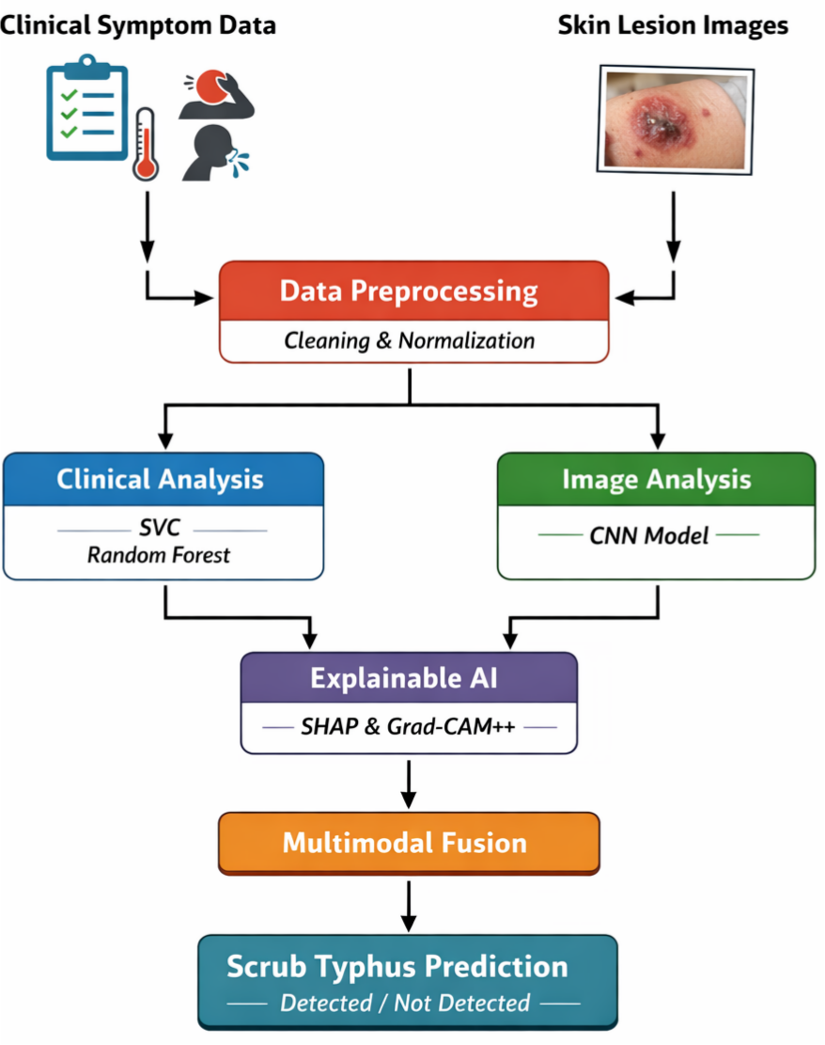
SYSTEM ARCHITECTURE

Slide 9
METHODOLOGY / ALGORITHM
Data Collection: Clinical symptom data and skin lesion images related to scrub typhus are collected.
Data Preprocessing: Clinical data is cleaned and images are resized and normalized for model processing.
Clinical Data Analysis: Random Forest and Support Vector Classifier (SVC) analyze clinical symptoms to predict scrub typhus.
Image Classification: A Convolutional Neural Network (CNN) model analyzes skin lesion images to detect scrub typhus patterns.
Explainable AI Analysis : SHAP explains clinical feature importance and Grad-CAM++ highlights important regions in images.
Multimodal Prediction: Clinical and image model predictions are combined to produce the final result.
Result Generation: The system outputs whether scrub typhus is detected or not with visual explanations.
Algorithms Used: Random Forest, Support Vector Classifier (SVC), Convolutional Neural Network (CNN), SHAP, and Grad-CAM++.

Slide 10
RESULTS & ANALYSIS
The performance of the proposed multimodal machine learning model was evaluated using metrics such as accuracy, precision, recall, F1-score, and ROC-AUC. These results were compared with previous studies to analyze the improvement in scrub typhus detection performance.
Paper / Model | Accuracy | Precision | Recall | F1-Score | ROC-AUC
Lu et al. (2025) – ML Prognostic Model | 0.65 | 0.70 | 0.55 | 0.68 | 0.56
Kanchanapiboon et al. (2024) – CNN Model | 0.72 | 0.71 | 0.60 | 0.70 | 0.60
Li et al. (2021) – Biosensor Detection | 0.69 | 0.65 | 0.71 | 0.65 | 0.65
Proposed Multimodal Model (This Work) | 0.75 | 0.74 | 0.73 | 0.73 | 0.78

Slide 11
TECHNOLOGIES USED
Programming Language: Python
Machine Learning Algorithms: Random Forest , Support Vector Classifier (SVC), Convolutional Neural Network (CNN)
Libraries / Frameworks: Pandas, NumPy, Scikit-learn, PyTorch / TensorFlow, Matplotlib, SHAP
Image Processing: OpenCV, Grad-CAM++, Development Environment, Google Colab, Jupyter Notebook
Web Page Development: Streamlit / Flask (for disease prediction interface)
Dataset Format: CSV (Clinical Data), JPG / PNG (Skin Lesion Images)

Slide 12
DATASETS / INPUT DETAILS
Clinical Dataset:
Dataset Name: Scrub Typhus Clinical Symptom Dataset
Source: Medical research datasets / simulated clinical dataset for machine learning experiments
Format: CSV file
Features: Fever, Headache, Myalgia, Eschar, Chills, Sweating, Vomiting, Rash, Lymph Gland Swelling
Purpose: Used to train machine learning models such as Random Forest and Support Vector Classifier (SVC) for disease prediction.
Image Dataset:
Dataset Name: Scrub Typhus Skin Lesion (Eschar) Image Dataset
Source: Public medical image sources such as Kaggle and open medical image repositories
Format: JPG / PNG images
Purpose: Used to train the CNN model for identifying skin lesion patterns related to scrub typhus.
Input to the System: Clinical symptom data (structured dataset), Skin lesion images (medical image dataset)

Slide 13
ADVANTAGES
Combines clinical data and skin image analysis for better disease detection.
Improves accuracy and reliability of scrub typhus classification.
Provides automated support for early diagnosis.
Uses explainable AI techniques to understand model predictions.
Helps healthcare professionals in faster decision making.
Reduces dependency on time-consuming laboratory tests.

Slide 14
LIMITATIONS
The model performance depends on the size and quality of the dataset.
Limited availability of scrub typhus skin lesion images.
Image quality variations may affect prediction accuracy.
The system may require high computational resources for deep learning models.
Clinical symptoms may overlap with other diseases, which can affect prediction accuracy.

Slide 15
FUTURE SCOPE
In the future, the system can be improved by using larger datasets to increase model accuracy. Advanced deep learning models such as EfficientNet or Vision Transformers can be used for better image analysis. The system can also be extended to detect multiple infectious diseases instead of only scrub typhus. In addition, it can be developed as a mobile or web application and integrated with medical data such as laboratory reports and patient history for better diagnosis.

Slide 16
CONCLUSION
This project presents a multimodal machine learning approach for scrub typhus detection using clinical symptom data and skin lesion images. Machine learning algorithms analyze the clinical features, while a deep learning model processes the skin images to identify disease patterns. The predictions from both models are combined to improve the accuracy and reliability of disease detection. Explainable AI techniques such as SHAP and Grad-CAM++ are used to understand the model predictions. The proposed system can assist healthcare professionals in early diagnosis and better decision making for scrub typhus detection.

Slide 17
REFERENCES
[1] Kala, D., & Sharma, R. (2020) – Reviewed different diagnostic methods for scrub typhus such as ELISA, PCR, and serological techniques.
[2] Liao, C. C., et al. (2021) – Proposed an ELISA-based diagnostic platform for accurate scrub typhus detection.
[3] Kim, M. G., et al. (2024) – Developed a molecular diagnostic platform to improve scrub typhus detection accuracy.
[4] Lu, Y., et al. (2025) – Used machine learning techniques to predict the severity of scrub typhus using clinical data.
[5] Kanchanapiboon, P., et al. (2024) – Applied deep learning and computer vision methods to analyze skin lesion images for scrub typhus detection.
[6] Li, F., et al. (2021) – Proposed a biosensor-based method for rapid detection of scrub typhus DNA.

Slide 18
Thank You

